Slide 1
Predicting the Risk of Company Bankruptcy Using Financial Indicators
Group 6
Chen Yayi (S2110521)
Cheng Ziyu (17141946)
Lee Voon Chung (S2142277)
Lee Voon Hee (S2140816)
Leow Jun Shou (17123313)
Link to RPubs: https://rpubs.com/voonhee_lee/WQD7004_G6

Slide 2
Introduction
According to Cambridge Dictionary (Cambridge University Press, 2022), bankruptcy refers to a situation in which a business or a person becomes unable to pay what is owed.
For this Group Project, a dataset comprising Polish companies bankruptcy status alongside their financial ratios were found on the Internet (Tomczak, 2016).

Slide 3
Research Questions
How is the performance of logistic regression and other machine learning classification models in predicting company bankruptcy?
Which financial ratios are important in predicting bankruptcy status of Polish companies?
Research Objectives
To build various logistic regression and machine learning classification models.
To compare prediction accuracies of models.
To identify the top five most important financial ratios associated with bankruptcy from logistic regression model.

Slide 4
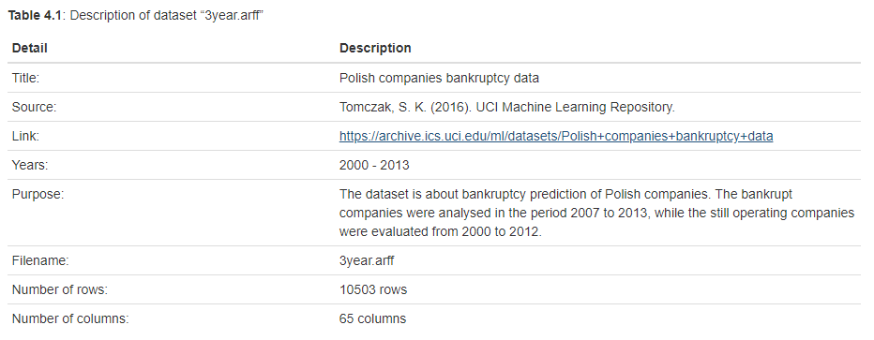
Description of Dataset

Slide 5
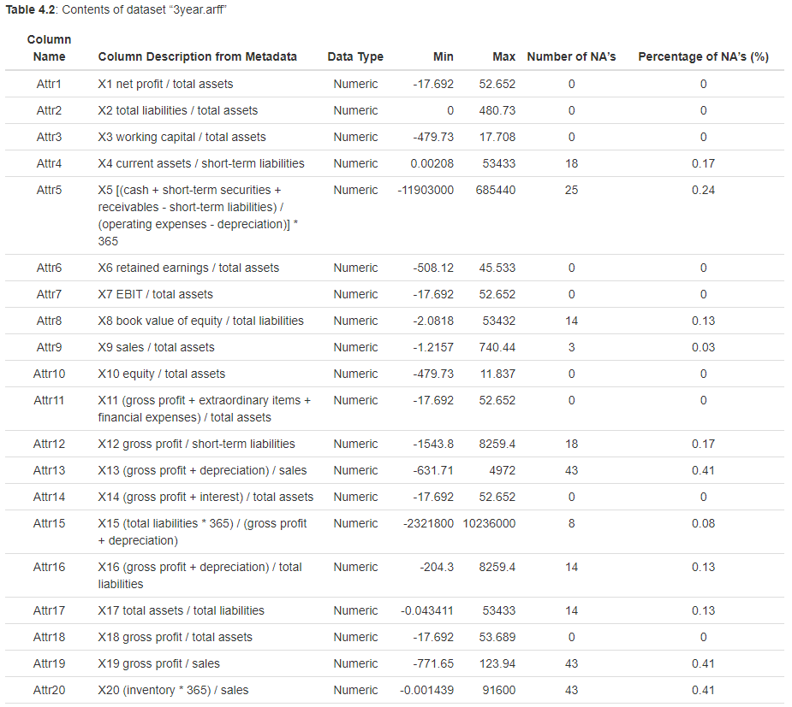
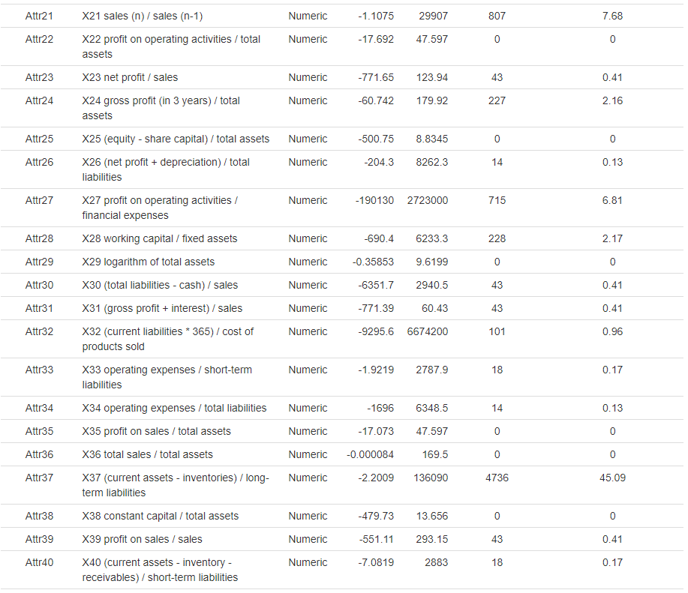

Slide 6
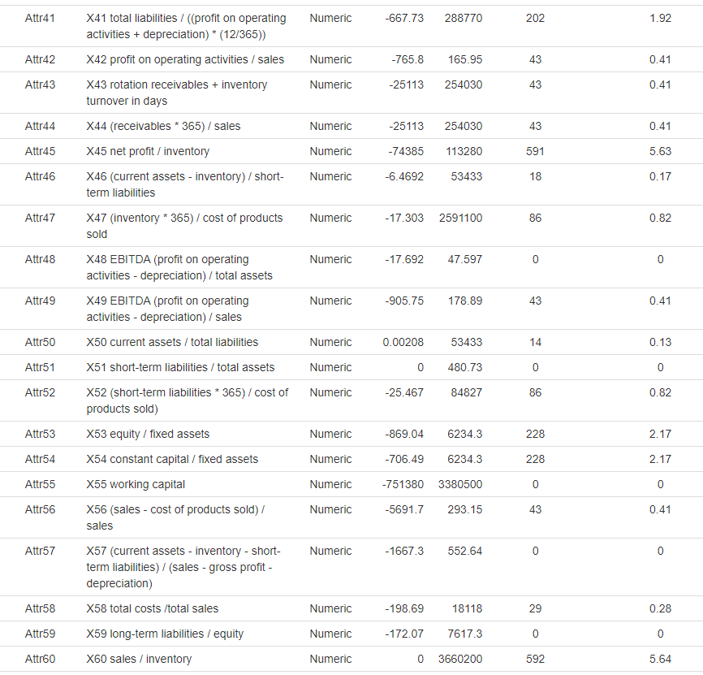
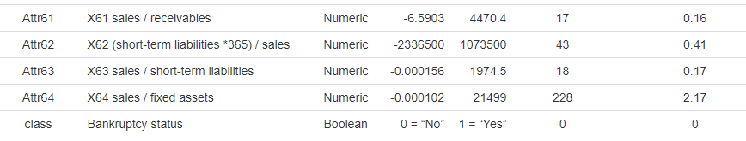

Slide 7
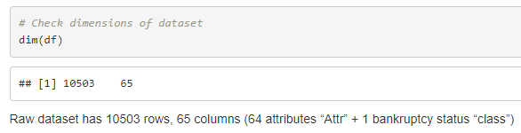
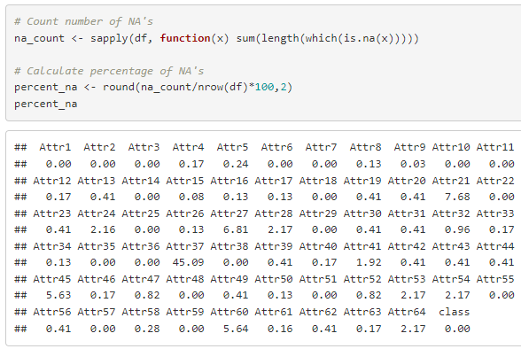
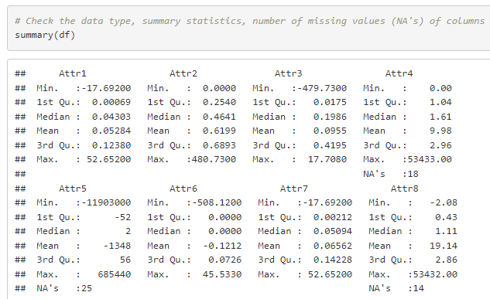
Data Cleaning and Pre-Processing
Step 1: Previewing dataset to have some general ideas of the dataset, such as dimensions, data type, range of values, number of missing values, etc.

Slide 8
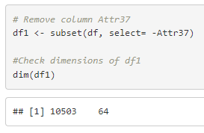
Data Cleaning and Pre-Processing
Step 2: Removing columns with percentage of NA’s > 10%
Attr37 has been deleted from the dataset as it comprises 45.09% of missing values. Imputation for these large number of missing values may introduce bias.

Slide 9
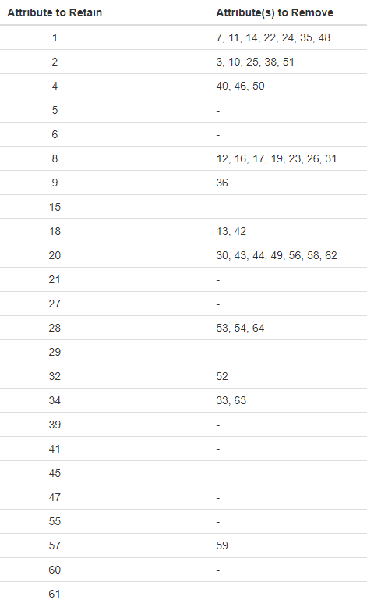
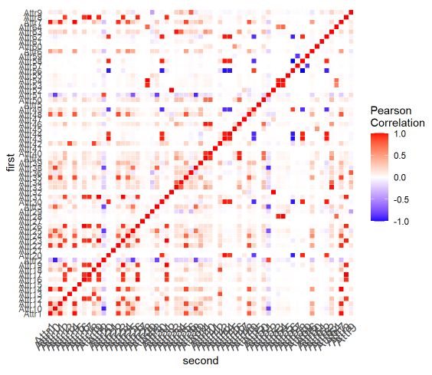
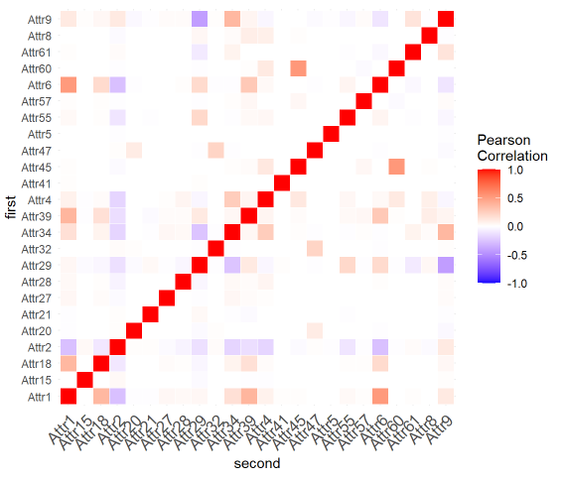
Data Cleaning and Pre-Processing
Step 3: Determining correlations between attributes and retaining one attribute from each highly correlated group.
24 attributes have been retained while 39 attributes have been deleted. This is to avoid collinearity problem in modelling.

Slide 10
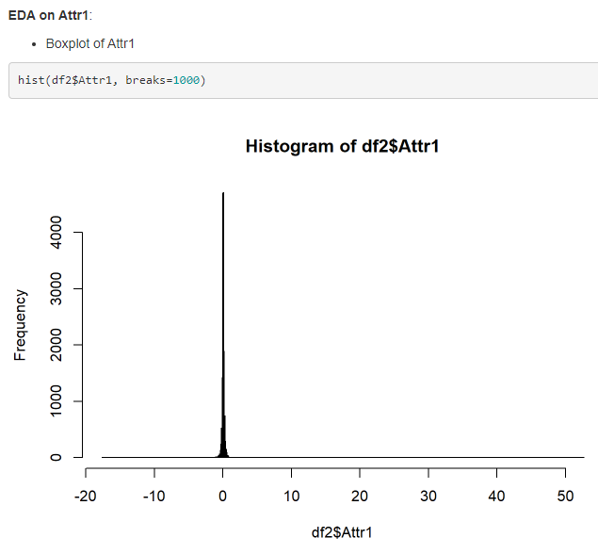
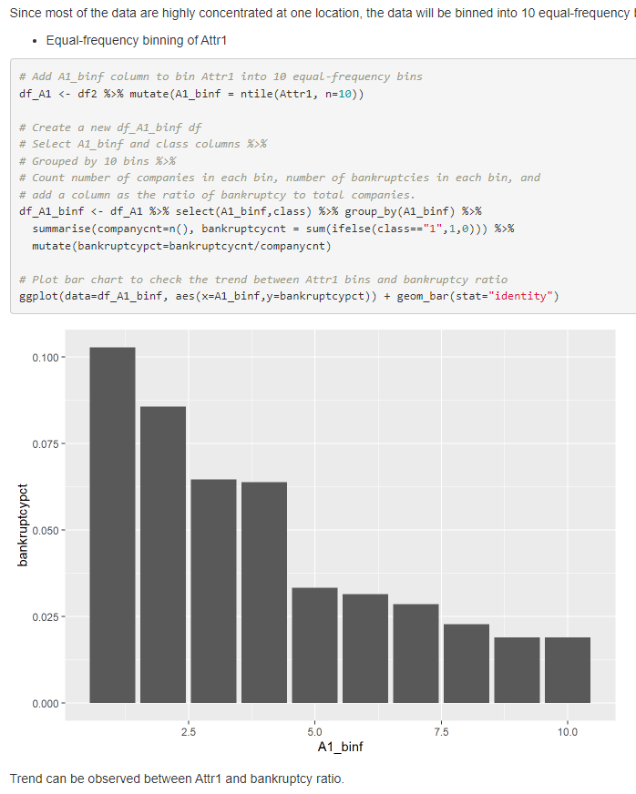
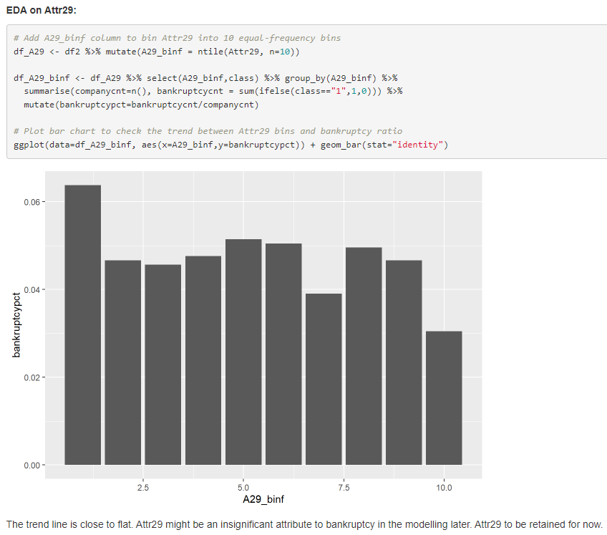
Data Cleaning and Pre-Processing
Step 4: Exploratory data analysis (EDA) to check for anomalies in all attributes. Attr6 has been deleted as it contains 42.6% of zeros, which is unlikely for this attribute.

Slide 11
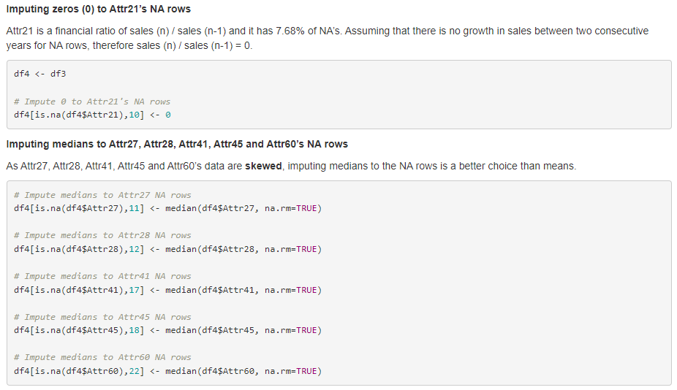
Data Cleaning and Pre-Processing
Step 5: Imputing columns with percentage of NA’s 1% to 10%.
Attr21, Attr27, Attr28, Attr41, Attr45 and Attr60 have been imputed with suitable constants for all the missing values, such as zeros or medians.

Slide 12
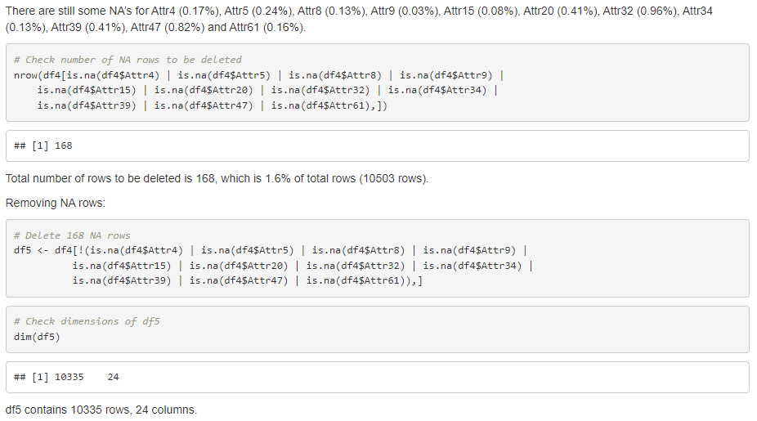
Data Cleaning and Pre-Processing
Step 6: Removing rows for columns with percentage of NA’s < 1%
A total of 168 rows (1.6%) have been deleted from the dataset.

Slide 13
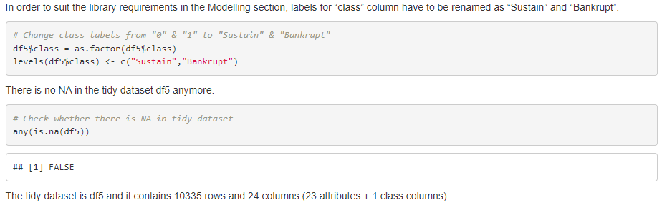
Tidy Dataset, Z-Score Normalisation, Data Partition & SMOTE
Tidy Dataset

Slide 14
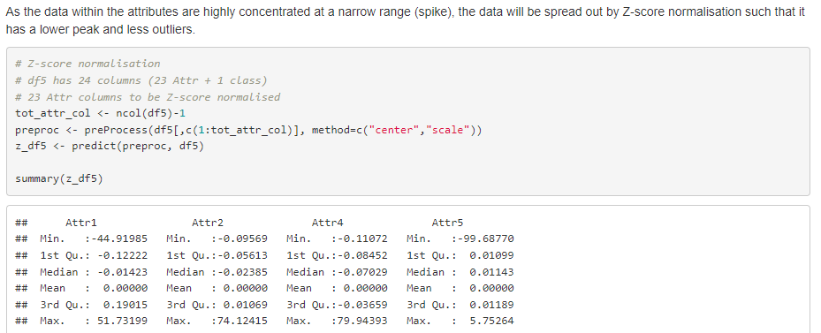
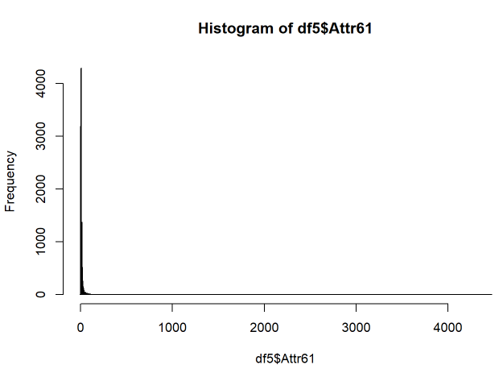
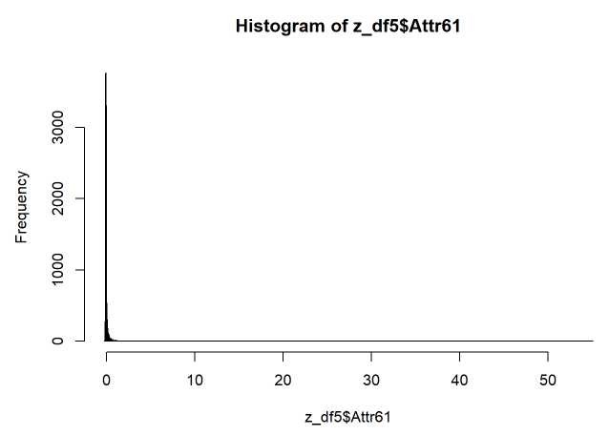
Tidy Dataset, Z-Score Normalisation, Data Partition & SMOTE
Data Transformation with Z-Score Normalisation

Slide 15
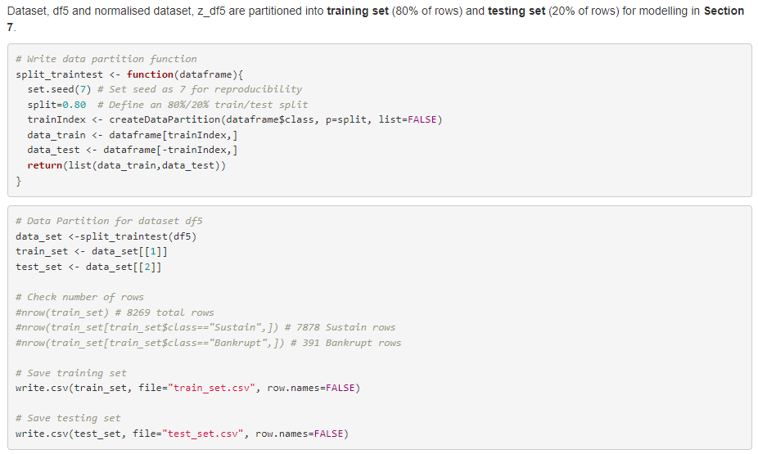
Tidy Dataset, Z-Score Normalisation, Data Partition & SMOTE
Data Partition (training : testing = 80% : 20%)

Slide 16
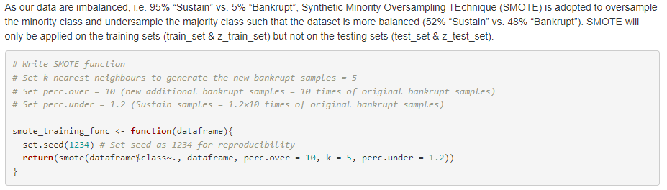
Tidy Dataset, Z-Score Normalisation, Data Partition & SMOTE
Oversampling & Undersampling with SMOTE

Slide 17
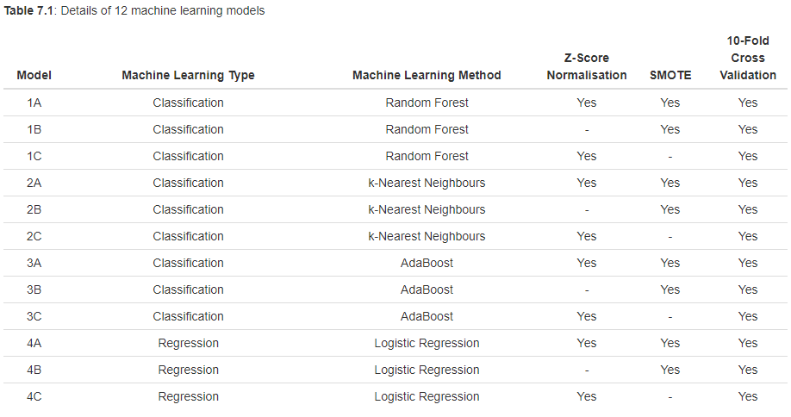
Modelling

Slide 18
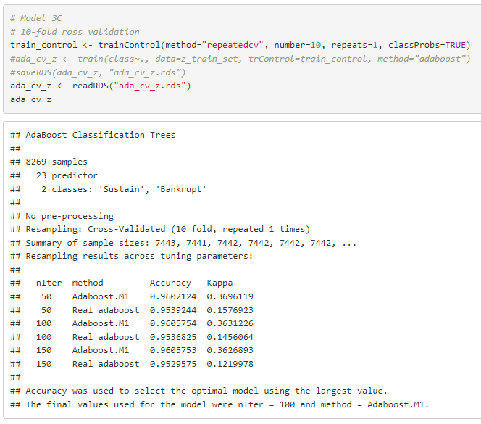

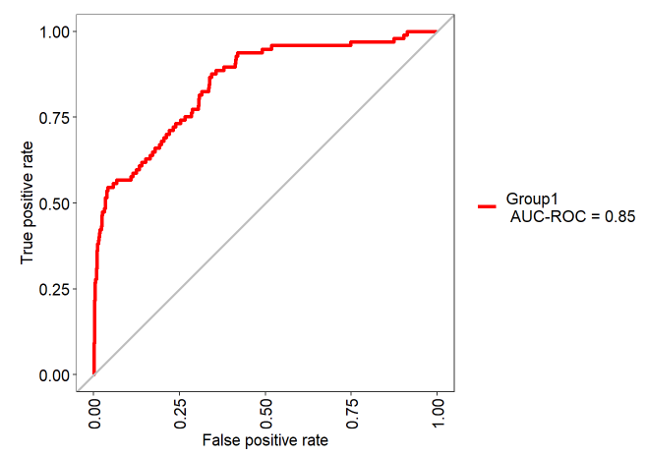
Example:
Model 3C: AdaBoost with Normalisation & Cross Validation

Slide 19
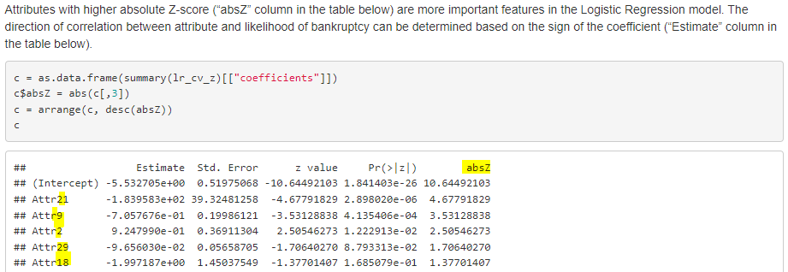
Modelling
Identifying Important Financial Ratios Associated with Bankruptcy through Logistic Regression Model (Model 4C)

Slide 20
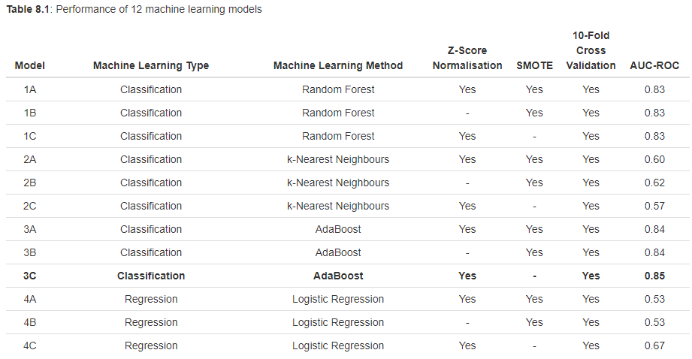
Results
As the “class” is considerably imbalanced (Sustain : Bankrupt = 95% : 5%), using Accuracy as performance metric is misleading. Accuracy is largely influenced by the majority class results even there is high inaccuracy in the minority class.
Area Under Curve of Receiver Operating Characteristic (AUC-ROC) will be adopted. AUC-ROC of 1 indicates a perfect classifier, whilst AUC-ROC of 0.5 (45-degree line) means random guessing.

Slide 21
Results
The results show that Model 3C (AdaBoost Classification with Z-score normalisation and 10-fold cross validation) is the best classifier with an AUC-ROC of 0.85.
In terms of machine learning method:
AdaBoost (0.84-0.85) and Random Forest (0.83) outperformed k-Nearest Neighbours (0.57-0.62) and Logistic Regression (0.53-0.67).
In terms of data treatment:
Adopting Z-score normalisation and/or SMOTE did not significantly affect the performance of Random Forest models;
k-Nearest Neighbour model worked well with SMOTE-treated data;
AdaBoost and Logistic Regression models performed better under Z-score normalised data.

Slide 22
Conclusions
9 classification models and 3 regression models were built to predict whether a Polish company will sustain or bankrupt based on the financial ratios provided.
Model 3C is the best classifier model amongst the 12 models. It is an AdaBoost Classification model fed with Z-score normalised data and trained with 10-fold cross validation.
The top five most important financial ratios in descending order obtained from the Logistic Regression Model 4C are:
Attr21 : sales (n) / sales (n-1), Attr9 : sales / total assets, Attr2 : total liabilities / total assets, Attr29 : logarithm of total assets, Attr18 : gross profit / total assets
The findings from the models are intuitive. Higher sales (Attr21 and Attr9) often brings more cash inflow into the company, hence lowering liquidity risk and bankruptcy risk.
A company with high leverage (Attr2) (i.e. high debt or liabilities relative to company size) may face higher difficulty in servicing loan interest and debt principal repayment, thus leading to a higher risk of bankruptcy.
A larger company (Attr29) often has more established management and operational processes, therefore reducing the risk of bankruptcy.
Companies which are profitable (Attr18) has a lower risk of bankruptcy inherently.

Slide 23
THANK YOU

